Slide 1
CafeCraft
APP PROJECT · PYTHON · TKINTER
5
pages, one window
Login and Signup · Home · Menu · Order · Receipt
Café Ordering and Management System
Submitted by:
Shreya Mandal
RA2511028010124
CSE CC / W2
Notes:
Introduce CafeCraft: a Tkinter desktop app where a customer logs in, browses the menu, builds an order and gets a receipt. Fill in your name, register number, faculty and course code on this slide.

Slide 2
Modules and their functions
PROJECT MODULES
Module | Functions | Purpose
Authentication | show_login_page, show_signup_page, handle_login, handle_signup, logout | Login and signup with validation
Home and Menu | show_home_page, show_menu_page, add_item_clicked | Welcome screen and 15 menu cards
Order and Billing | show_order_page, change_quantity, remove_item, calculate_subtotal, calculate_total | Edit the order, bill updates itself
Receipt | place_order, generate_receipt_text, show_receipt_page, start_new_order | Order number, items and total
Helpers | clear_page, update_status, make_button, make_entry, make_label | Page switching, status bar, styling
CafeCraft · Café Ordering and Management System
2 / 15
Notes:
Walk through the five groups of functions. Data lives in dictionaries (MENU, accounts, current_order), so there is no database.

Slide 3
Widgets in CafeCraft
TKINTER COMPONENTS USED
Tk() root window
Frame
Label
Main window: title, minimum size, opens zoomed.
page_frame holds each page; also cards and button rows.
Headings, prices, the receipt slip and the status bar.
Button
Entry
Radiobutton
Every action button, built by make_button().
Login and signup boxes; show="*" hides passwords.
Order type: Dine-in or Takeaway, one choice only.
Checkbutton
Canvas + Scrollbar
ttk.Separator
Need cutlery: tick or untick, on or off.
The order table scrolls when the order gets long.
Thin line above the total bill on the order page.
CafeCraft · Café Ordering and Management System
3 / 15
Notes:
These are the widgets the code really uses. Radiobutton gives one choice from several (they share one variable); Checkbutton is a single on/off choice. The Canvas holds the order table and the Scrollbar is linked to it with yview.

Slide 4
Other Tkinter concepts used
TKINTER COMPONENTS USED
Tkinter variables
Message boxes
Events and binding
Focus handling
StringVar: order type, status bar, menu message. IntVar: cutlery tick.
showinfo, showerror, showwarning and askyesno (Logout, Place Order).
command= for clicks; bind() for the Enter key and mouse hover.
focus() puts the cursor in the first login and signup box.
Window management
Layout managers
winfo methods
title, minsize and state("zoomed") open the app maximised.
grid() for forms, cards and table rows; pack() for pages and button rows.
winfo_children clears a page; winfo_reqwidth and reqheight size the table.
CafeCraft · Café Ordering and Management System
4 / 15
Notes:
Not used in this project but possible viva topics. If asked, answer from your notes: Text is a multi-line editor, Listbox shows a list to pick from, Menu makes menu bars, Toplevel opens a second window, Treeview shows a table or tree.

Slide 5

A café-themed interface
GUI DESIGN AND IMPLEMENTATION
Café theme
Zoomed window
Layouts
Helpers
Coffee brown, caramel and cream, with Segoe UI fonts.
Opens maximised; one shared frame is redrawn per click.
grid() for forms and menu cards, pack() for rows.
make_button, make_label and make_entry keep pages uniform.
THE FIVE PAGES
Login and Signup
Home
Menu
Order
Receipt
COLOUR PALETTE
#241A16
#382820
#C58B55
#F3E5D0
Window background
Cards and panels
Headings, main buttons
Inputs, second buttons
CafeCraft · Café Ordering and Management System
5 / 15
Notes:
Explain the theme and layout choices. The screenshots of every page follow on the next four slides.

Slide 6
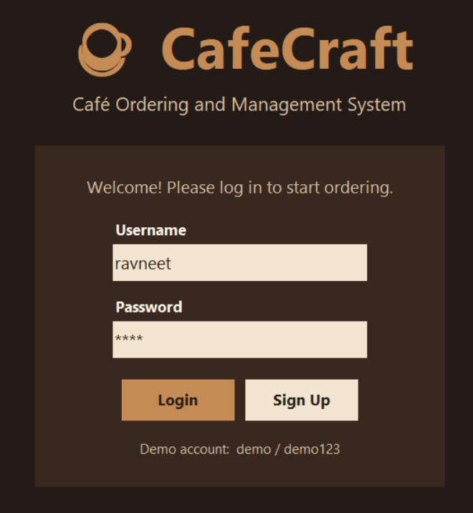
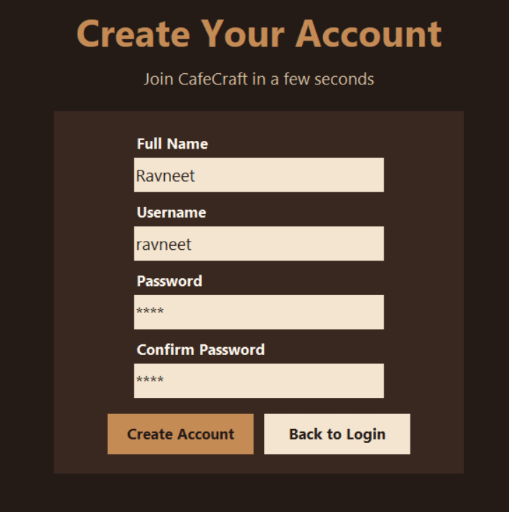
Login and Signup
GUI DESIGN AND IMPLEMENTATION · OUTPUT
Login page
Signup page
Username and password; the demo account is shown.
Four fields; passwords are hidden with *.
CafeCraft · Café Ordering and Management System
6 / 15
Notes:
Login checks that both boxes are filled, then compares with the accounts dictionary. Signup checks all fields, a unique username and matching passwords.

Slide 7
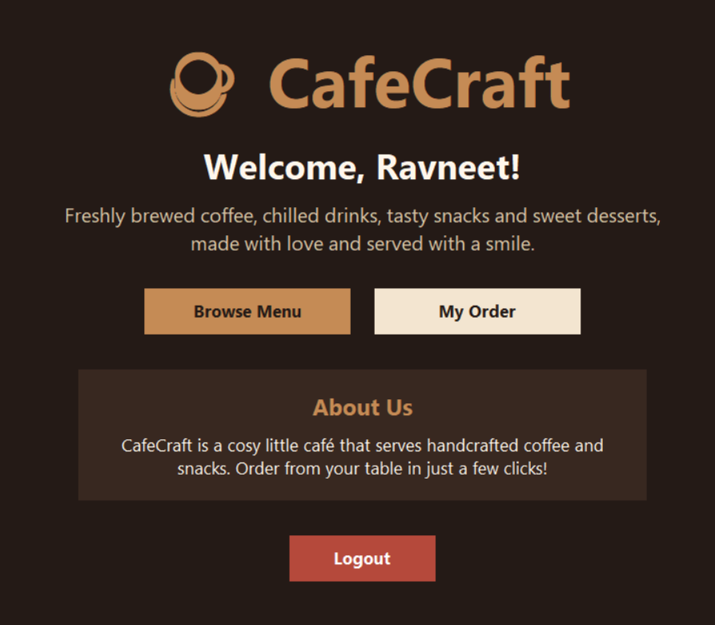
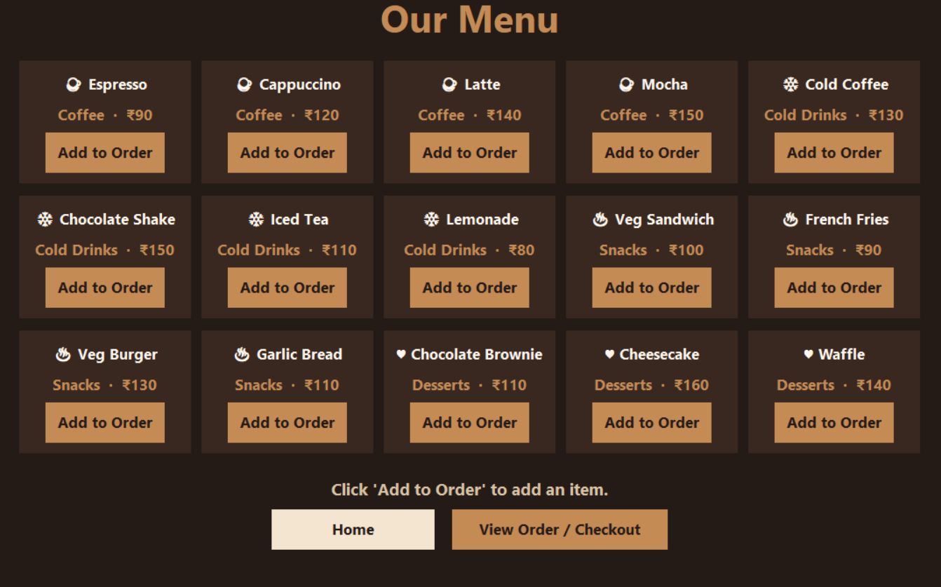
Home and Menu
GUI DESIGN AND IMPLEMENTATION · OUTPUT
Home page
Menu page
Welcome message, Browse Menu, My Order and About Us.
Fifteen items in five columns, each with Add to Order.
CafeCraft · Café Ordering and Management System
7 / 15
Notes:
The menu cards are built in a loop over the MENU dictionary, five per row. The message under the cards confirms each item added.

Slide 8
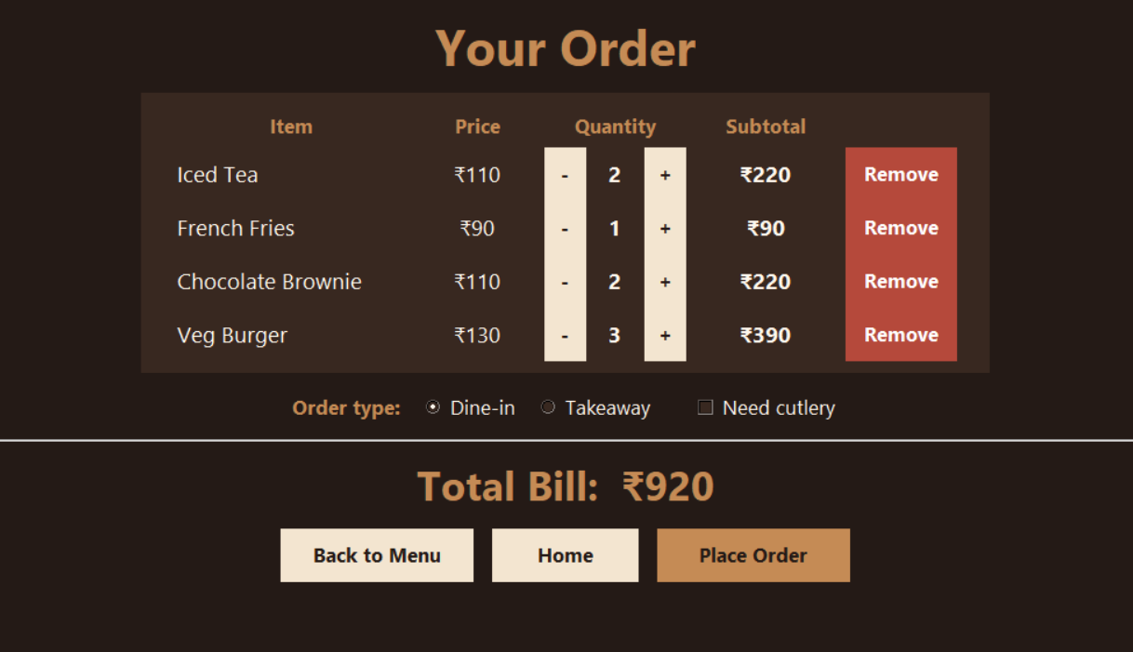
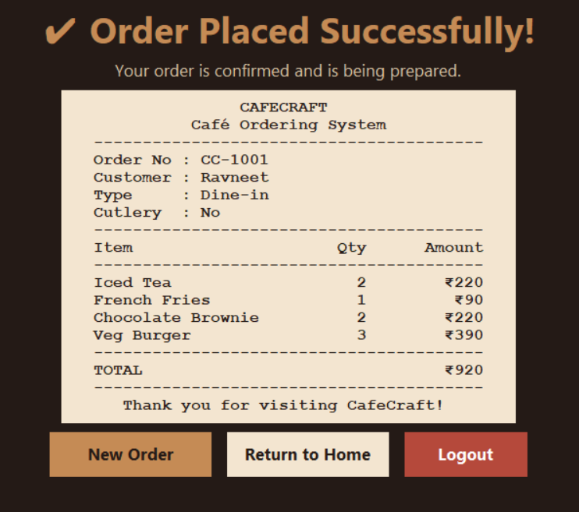
Order and Receipt
GUI DESIGN AND IMPLEMENTATION · OUTPUT
Order page
Receipt page
Quantity buttons, order type, cutlery option and total bill.
Order number, items, subtotals and total.
CafeCraft · Café Ordering and Management System
8 / 15
Notes:
Check the arithmetic on screen: 2 × 110 + 90 + 2 × 110 + 3 × 130 = 920. The receipt is built from the saved copy of the order, so it matches the order page exactly.

Slide 9
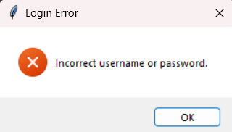
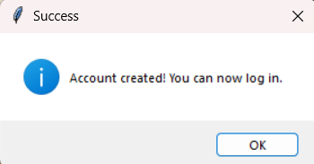
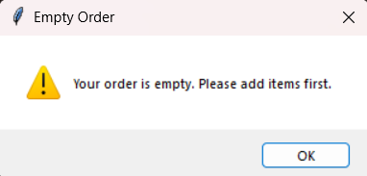
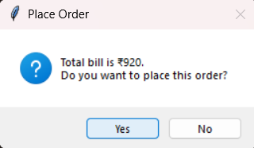
Message boxes
CODE IMPLEMENTATION AND EVENT HANDLING · OUTPUT
Wrong login
Signup success
showerror
showinfo
Shown when the username or password is incorrect.
Shown after Create Account succeeds.
Empty order
Place Order question
showwarning
askyesno
Shown when Place Order is pressed with nothing added.
Asks Yes or No before the order is placed.
CafeCraft · Café Ordering and Management System
9 / 15
Notes:
Four kinds of Tkinter message box: showerror, showinfo, showwarning and askyesno. Each one stops the user, shows a short message and waits for a click before the program continues.

Slide 10
Page navigation and data
CODE IMPLEMENTATION · NAVIGATION MODULE
Shared frame
Clear the shared frame
One page_frame holds every page; a status bar sits below it.
def clear_page():
for widget in page_frame.winfo_children():
widget.destroy()
update_status()
Switching pages
clear_page() deletes the old widgets, then the next page is drawn.
A button opens the next page
make_button(button_row, "Browse Menu",
show_menu_page, "primary", 18)
Data in memory
Dictionaries store the menu, accounts and current order.
Data structures
MENU = {"Latte": {"category": "Coffee", "price": 140}}
accounts = {"demo": {"full_name": "Demo User", ...}}
current_order = {"Latte": 2, "Espresso": 1}
CafeCraft · Café Ordering and Management System
10 / 15
Notes:
Every page function starts with clear_page(). Pages are not separate windows: the same frame is emptied and refilled. The code shown is trimmed; the full functions are in cafecraft.py.

Slide 11
Login and signup validation
CODE IMPLEMENTATION · AUTHENTICATION MODULE
Login checks
handle_login (trimmed)
Fields not empty, username exists, password matches.
username = login_username_entry.get().strip()
password = login_password_entry.get()
if username == "" or password == "":
messagebox.showerror("Login Error", ...)
return
if username in accounts and \
accounts[username]["password"] == password:
show_home_page()
Signup checks
All fields filled, username unused, both passwords equal.
Early return
handle_signup (trimmed)
Each failed check shows a pop-up and stops the function.
if username in accounts: ... return
if password != confirm: ... return
accounts[username] = {"full_name": full_name, "password": password}
CafeCraft · Café Ordering and Management System
11 / 15
Notes:
Login reads the Entry boxes with .get(). The demo account is demo / demo123. The ... in the snippets stands for the message text; the full code is in cafecraft.py. Passwords are stored as plain text, which is a limitation to mention.

Slide 12
Order and bill calculation
CODE IMPLEMENTATION · ORDER AND BILLING MODULE
Subtotal
Subtotal and total
Unit price × quantity for each item.
def calculate_subtotal(item_name, quantity):
return MENU[item_name]["price"] * quantity
def calculate_total(order):
total = 0
for item_name, quantity in order.items():
total += calculate_subtotal(item_name, quantity)
return total
Total bill
Sum of all subtotals: Latte 2 × 140 + Espresso 90 = 370.
Always up to date
The page is redrawn after every change, so the total is recalculated.
Plus and minus buttons
def change_quantity(item_name, change):
current_order[item_name] += change
if current_order[item_name] <= 0:
del current_order[item_name]
show_order_page()
CafeCraft · Café Ordering and Management System
12 / 15
Notes:
change_quantity is called with +1 or -1. When a quantity reaches zero the item is deleted. remove_item deletes the key directly. No total is stored anywhere: it is recalculated each time the order page is drawn.

Slide 13
Placing an order and the receipt
CODE IMPLEMENTATION · RECEIPT MODULE
Save a copy
place_order (trimmed)
The order and its options are copied into last_receipt first.
if len(current_order) == 0: ... return
if not messagebox.askyesno(...): return
order_counter += 1
last_receipt = {"order_number": "CC-" + str(order_counter),
"items": current_order.copy(),
"total": calculate_total(current_order),
"order_type": order_type.get(),
"cutlery": cutlery_needed.get()}
clear_order()
show_receipt_page()
Order number
A counter goes up by one for each order: CC-1001, CC-1002.
Real data only
The receipt loops over the saved items. Nothing is hardcoded.
generate_receipt_text (trimmed)
for item_name, quantity in last_receipt["items"].items():
subtotal = calculate_subtotal(item_name, quantity)
lines.append(f"{item_name:<20}{quantity:>4}{subtotal:>12}")
CafeCraft · Café Ordering and Management System
13 / 15
Notes:
The f-string widths (:<20 left-align, :>12 right-align) line the columns up in the Courier receipt. In the real code the amount also gets a rupee sign; it is left out here to keep the line short.

Slide 14
How the buttons do their work
CODE IMPLEMENTATION AND EVENT HANDLING
Button commands
Button command, key and mouse binding
command=handle_login runs on click, with no brackets.
make_button(row, "Login", handle_login)
login_password_entry.bind("<Return>", handle_login)
button.bind("<Enter>", lambda event: button.config(bg=TEXT_SOFT))
Keyboard and mouse
bind() handles the Enter key and the hover colour.
Menu button with lambda
make_button(card, "Add to Order",
lambda n=item_name: add_item_clicked(n))
Lambda in loops
n=item_name remembers which item each button belongs to.
Order dictionary
def add_to_order(item_name):
if item_name in current_order:
current_order[item_name] += 1
else:
current_order[item_name] = 1
Pop-ups and options
messagebox confirms; Radio and Check buttons use variables.
CafeCraft · Café Ordering and Management System
14 / 15
Notes:
Tkinter waits in mainloop() for events. A click calls the function given in command=. bind() attaches other events such as Return, Enter and Leave (mouse hover). The lambda default n=item_name freezes the current item; without it every button would add the last item of the loop. The Radiobuttons share one StringVar (order_type) and the Checkbutton uses an IntVar (cutlery_needed); the widget and its variable stay linked automatically. A dictionary key exists only once, so adding the same item again only raises its quantity.

Slide 15
What CafeCraft delivers
CONCLUSION
What is built
What it shows
Future scope
Five pages in one window
Login and signup validation
15-item menu, live billing
Receipt from real order data
Functions and dictionaries
Input validation
Events, bind and lambda
Entry, Radiobutton, Checkbutton, Canvas
SQLite database for saved data
Hashed passwords
Admin screen to edit the menu
Order history and PDF receipts
Thank you
CafeCraft
Python · Tkinter
CafeCraft · Café Ordering and Management System
15 / 15
Notes:
Summary: CafeCraft is a complete five-page Tkinter ordering app. It uses only built-in Python, keeps data in dictionaries and shows validation, billing and event handling working together. Limitations: data is lost when the program closes and passwords are stored as plain text. A database and hashed passwords are the natural next steps.

